Slide 1
Environmental Issues around the Dairy Sector in Tanzania.
Author: Godfrey Ngoteya
Position: CRP Field Coordinator
Email: G.Ngoteya@cgiar.org
Date: June 2020

Slide 2
Importance of Dairy Enterprises in Tanzania.
The dairy industry is among the important components of the livestock sector in Tanzania.
It contributes about one-third of the 5.4% livestock industry’s contribution to the GDP
The industry has even greater potential for improving the living standards of people through improved nutrition arising from milk consumption and incomes raised from sales of milk and milk products.
Smallholder dairy farming is growing in Tanzania at a rate of 6% per year, with an estimated 190,000 farmers registered in the Smallholder dairy development schemes countrywide. (Livestock sector employs 50% i.e. 4.6 million HH)
The high-potential areas for the dairy schemes include, Northern and Southern Highlands (Kilimanjaro, Arusha, Mbeya and Iringa regions) whilst the medium-potential areas includes Tanga and Kagera regions in the Coastal and Lake zones, respectively.
Out of the estimated 21.3 million cattle in Tanzania, about 680,000 are dairy cattle mainly crosses of Friesian, Jersey, and Ayrshire breeds with the Tanzania Shorthorn Zebu (TSZ)
Up to 2018, the total annual milk production was being estimated at 2.4 billion litres a rise from around 2 billion litres per year in 2003
About 70% of the milk produced comes from the traditional sector (indigenous cattle) kept in rural areas (1.6 million HH), while the remaining 30% comes from improved cattle (740,000 cattle) mainly kept by smallholder producers (218,418 HH).
Notes:
Discuss on one of the enterprises:
How much does it contribute to GDP?
How many people are involved in the country?

Slide 3
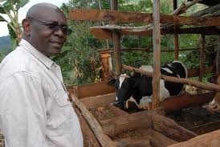
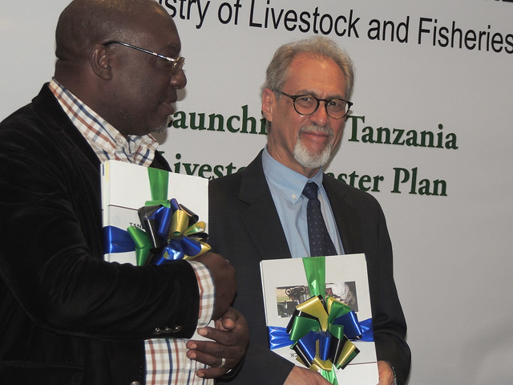
Livestock Master Plan and Future Projections
A five-year (2017/18 to 2021/2022) Livestock Master Plan for Tanzania (TLMP) was officiated earlier in 2019 with a net budget of around TZS1.4 trillion (USD596 million)
(https://www.mifugouvuvi.go.tz/uploads/projects/1553601793-TANZANIA%20LIVESTOCK%20MASTER%20PLAN.pdf).
In this Master plan, Tanzania envisages;
A 77% increase in national cow milk production as a result of the proposed interventions, including artificial insemination, hormone synchronization, multiple ovulation and embryo transfer, combined with improved feed and health interventions, value addition and complementary policy changes during the ASDPII period (2017–2022).
An increase in surplus dairy milk produced in the country by 1,002 litres over the projected domestic consumption requirements
That the milk production targets in the ASDPII will be met and the growing domestic demand for milk will be exceeded by 35%.
The number of crossbred dairy cows is projected to increase by 281% and milk production per cow by 26-42% and due to that,
The contribution of the dairy sector to the GDP is also expected to rise by 75% .
The plan also notifies that access to land appropriate for grazing, and land for feed production needs to be addressed to overcome the serious existing feed deficit
Notes:
Change the photo:
Are the any masters plans for livestock or big implementation policies in the country? If yes kindly state and if possible a link to the master plan (if you have it on hard copy send that through)
What are the key messages for development? Grow by what percentage? To achieve what?

Slide 4
Environmental challenges and opportunities in the Dairy sector in TZ
Challenges:
Ever increasing overgrazing and environmental degradation of rangelands, forest ecosystems, pastures and farmlands (Depletion of carbon stocks)
Increasing soil erosion and nutrient losses, as well as degradation of the water catchments due to overgrazing of agricultural and rangelands.
As dairy production systems intensify towards industrial and feedlot systems, manure disposal issues become more serious (e.g. Climate change issues due to green house effect e.g. methane, nitrous oxide, and carbon dioxide).
Inadequate legal framework in land ownership i.e. Most of the grazing land is owned communally therefore no incentives for people to manage grazing lands.
Opportunities for Mitigating Challenges:
Encouraging partnerships towards capacity building of the local communities in managing and conserving communal grazing lands and the environment especially through participatory rangeland and Forest management systems.
Promoting agroforestry (i.e. multipurpose trees, legumes and grasses/fodder) towards improving grazing lands
Promoting manure management initiatives e.g. Capacity building of the Biogas Enterprises etc.
Advocating for policy reforms to secure land ownership for dairy farmers
Notes:
Name the key environmental challenges from the livestock sector ( 2 should suffice)
Are there ways to mitigate these challenges (e.g better feeds, biogas etc), current innovations/technologies

Slide 5
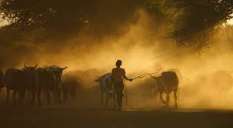
Environmental Benchmarks in Tanzania
Tanzania has in place the National Environmental Policy (NEP), 1997 and the National Environmental Action plan (NEAP 2013), and the Environmental Management Act (2004) that helps to provide necessary legislations for regulating use and management of natural resources in the country.
There are however “No clear country specific environmental benchmarks ” towards reducing the risks associated with dairy activities to the environment.
This calls for country-wide initiative to study the specific value chain activities and their associated impacts on environment that would inform an array of choices needed to set sectoral environmental targets.
Notes:
Are there specific country targets to lower environmental impacts . E.g. Carbon emissions, soil erosion.
Discuss 2 points

Slide 6
Thank you!
Author: Godfrey Ngoteya
Position: CRP Field Coordinator
Email: G.Ngoteya@cgiar.org

